Slide 1
NOISE POLLUTION MONITORING

Slide 2
PROJECT DEFINITION
This large amount of increasing pollution has made human life prone to large number of diseases.
Therefore, it has now become necessary to control the pollution to ensure healthy livelihood and better future. Here i propose a noise pollution monitoring system that allows us to monitor and check live sound pollution in a areas through IOT.
Also system keeps measuring sound level and reports it to the online server over IOT. The sensors interact with microcontroller which processes this data and transmits it over internet.
This allows authorities to monitor noise pollution in different areas and take action against it.
Also authorities can keep a watch on the noise pollution near schools, hospitals and no honking areas, and if system detects noise issues it alerts authorities so they can take measures to control the issue.

Slide 3
DESIGN THINKING
PROJECT OBJECTIVES
IOT SENSOR DESIGN
NOISE POLLUTION INFORMATION PLATFORM
INTEGRATION APPROACH

Slide 4
PROJECT OBJECTIVES
REAL TIME NOISE POLLUTION MONITORING:
Real-time noise pollution monitoring refers to the continuous and immediate measurement, analysis, and reporting of noise levels in a specific area or environment.
This process typically involves the use of specialized sensors or equipment that can detect and record noise levels in real time.
The data collected is then transmitted to a central system or platform, allowing authorities, researchers, or individuals to monitor and assess noise pollution levels as they occur.
This information is crucial for identifying sources of noise pollution, implementing effective mitigation measures, and ensuring that noise levels comply with established regulations to protect the well-being of communities and the environment.

Slide 5
PUBLIC AWARENESS:
Noise pollution public awareness refers to efforts and initiatives aimed at educating the general public about the adverse effects of excessive noise on health, well-being, and the environment.
It involves raising awareness about the sources of noise pollution, its impact on daily life, and the steps individuals can take to reduce noise pollution in their communities.
Such awareness campaigns often highlight the importance of responsible noise management, adherence to noise regulations, and the adoption of noise-reducing measures to create quieter and more pleasant living environments.
Ultimately, noise pollution public awareness seeks to empower individuals and communities to take informed actions to mitigate noise pollution and improve overall quality of life.

Slide 6
NOISE REGULATION COMPLIANCE:
Noise regulation compliance involves adhering to established laws and guidelines governing permissible noise levels in specific areas or activities.
It entails implementing measures to reduce noise emissions, utilizing noise-reducing technologies, and ensuring that businesses, industries, and individuals operate within acceptable noise limits to minimize the impact of noise pollution and maintain a quieter environment.

Slide 7
IMPROVED QUALITY OF LIFE:
Reducing noise pollution leads to an improved quality of life by fostering peaceful environments that enhance sleep, concentration, and mental well-being.
It also reduces stress, hearing impairment, and related health issues, contributing to overall better physical and emotional health.

Slide 8
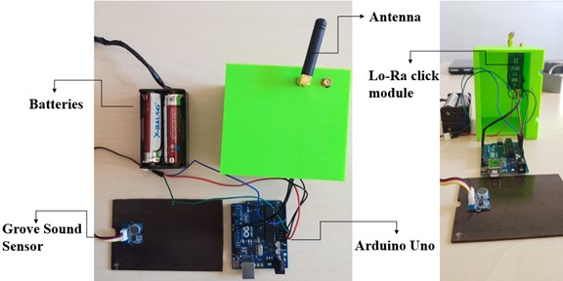
IOT SENSOR DESIGN
A sound sensor detects sound waves and converts them into electrical signals.
It combines a microphone and processing circuitry on a small board.
It measures sound intensity and produces a digital output signal using a microphone and LM393 level comparator chip.

Slide 9
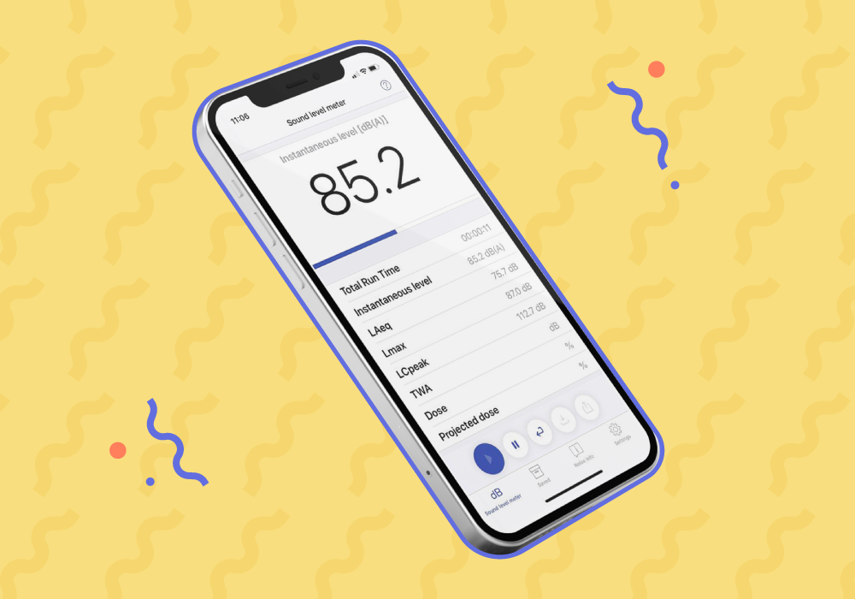
NOISE POLLUTION INFORMATION PLATFORM
The noise tracker is a real time noise monitoring application dedicated to evaluate noise levels in the surrounding environment as professional sound meter performs.
This App will use the phone microphone to measure environmental noise levels.

Slide 10
INTEGRATION APPROACH
IoT sensors for noise pollution typically use wireless communication technologies, such as Wi-Fi, cellular networks, or low-power protocols like LoRa or Zigbee, to send data to a central information system.
These sensors continuously measure noise levels and transmit the data at regular intervals or when predefined thresholds are exceeded.
The data is then processed and analyzed in real-time, making it accessible to authorities, researchers, or the public through web-based platforms or mobile applications.
This real-time data dissemination enables timely responses to noise pollution issues and facilitates informed decision-making for noise control and mitigation efforts.

Slide 11
These are topics of phase-1: NOISE POLLUTION MONITORING
By Team mates:
1.Ezhilarasi.A
2.Hruthik kumar J.S
3.Iswariya.L
4.Kalpana.G
5.Kanishka.k

